Slide 1
CCM guidance documents: current situation, gaps, recommendations
CCM Meeting
06 March 2024
А. Katasonova, I. Isakova

Slide 2
A brief overview of the process
Analysis of existing CCM Kyrgyzstan documents, Global Fund documents, as well as examples of documents from other countries in the region
Meetings with members of the current CCM (including the CCM Chair) as well as some members of previous CCMs. It was not possible to meet with all CCM members, but all sectors were covered.
Multiple sessions with the Global Fund

Slide 3
Core Principles of the Global Fund for CCMs
Partnership
Engagement of key populations7 people living with or affected by diseases and civil society
Oversight
Building on national structures
Sustainability and transition
Good governance
Differentiation

Slide 4
The Eligibility Requirements 1-2
Compliance with requirements 1 and 2 is assessed at the time of submission of the funding request.
The Global Fund requires all CCMs to:
1. Coordinate the development of all funding requests through transparent and documented processes that engage a broad range of stakeholders, including CCM members and non-members, in the solicitation and the review of activities to be included in the funding request; and Clearly document efforts to engage Key Populations10 in the development of funding requests
2. Nominate one or more PR(s) at the time of submission of the funding request(s); Document a transparent process for the nomination of all new and continuing PR(s) based on clearly defined and objective criteria; and Document the management of any conflicts of interest that may affect the PR(s) nomination process

Slide 5
The Eligibility Requirements 3-6
Compliance with requirements 3 to 6 is assessed both at the time of submission of the funding request and on a yearly basis throughout the period of Global Fund financing
3. to submit and follow an oversight plan for all Global Fund approved financing.
4. to show evidence of membership of:
people that are both living with and representing people living with HIV;
people affected by and representing people affected by tuberculosis and malaria; and
people from and representing Key Populations
5. all CCM members representing nongovernment constituencies to be selected by their own constituencies based on a documented, transparent process, developed within each such constituency.
6. abide by the highest standards of ethics and integrity

Slide 6
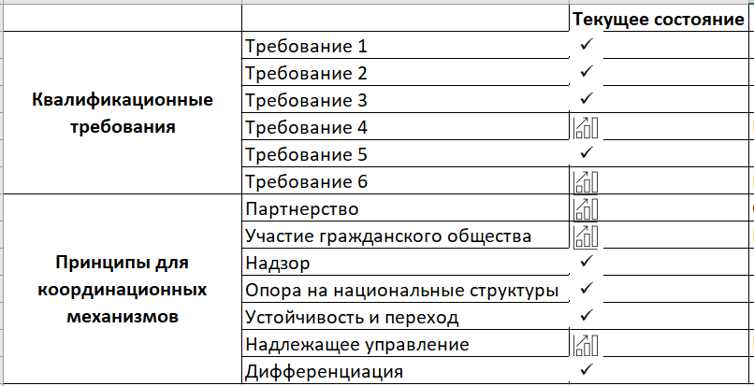
Current situation

Slide 7
Current situation (requirements 1-6)

Slide 8
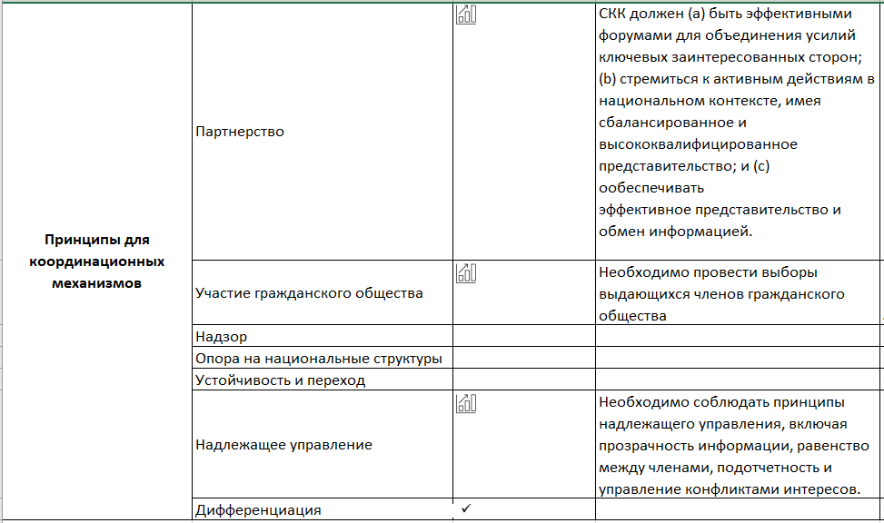
Current situation (core principles)

Slide 9
Recommendations and notes to them(1)
Rename "CCPH Committee on HIV and TB" to "Country Coordinating Mechanism for Engagement with the Global Fund to Fight AIDS, Tuberculosis and Malaria at the CSRC" (abbreviated as CCM). | To minimize confusion over committee names (CCPH and CCPH Committee) and to create a clear separation between the CCPH and CCM
Sectors to be named as follows: Government (11) Non-Government (7) International (3) | This distribution clearly distinguishes international organizations and also provides a potential opportunity to include academia and the private sector in the non-government sector.
Non-government sector to increase to 9 members (without reducing other sectors), increasing representation to 40% of CCM membership Note here this is link to the Decision Making % recommendation, so they see the options | With a total of 23 CCM members, the distribution will be more balanced while remaining state-driven: Government sector - 11 seats - 48% Non-Government Sector - 9 seats - 39% International Sector - 3 seats - 13%

Slide 10
Recommendations and notes to them (2)
New CCM membership to be selected at the beginning of the 2nd or 3rd year of the grant Alternatively, to renew ⅓ or only a part of CCM every 3 years - so that the institutional memory is kept | If CCM membership is renewed at the beginning of grant year 1, then (a) the new CCM members do not know anything about the new grant, as they did not participate in its development and approval the year before; (b) if the selection of CCM members is delayed, there may be a delay in signing the new grant (which is signed by the CCM chair and vice-chair from different sectors) or signing the grant without a civil society representative.
the CCPH to approve the Regulations, respectively only the qualitative and quantitative composition of CCM. Remove the clause on approval of CCM member nominees by the CCPH; nominees should be accepted and approved by the CCM on the basis of predetermined criteria. | Specific composition of the CCM membership, admission and expulsion of members should be considered and approved at CCM meetings. Approval or non-approval of new CCM members should be done at CCM meetings and only on the basis of formal criteria: criminal record, absence of two consecutive terms on the CCM , and a transparent selection procedure for civil society representatives. In case of rejection of a candidate, the reasons should be specified with reference to a specific clause of the Regulations.

Slide 11
Recommendations and notes to them (3)
Conduct new elections for CCM members from the civil society sector online with the involvement of an external moderator to shorten the time until a full CCM is formed. | Online elections in the format of a conference with a large number of participants, where the floor is given by a moderator with a specific time limit on speeches, plus an external moderator, with no conflict of interest, will reduce the election process from several months to a few weeks.
Rename "sectors" for oversight and funding requests to "committees" | To eliminate confusion with the government, civil and international sectors
Quorum should be al least 2/3 of the total number of CCM members and at least 1 member each from the international and non-governmental sectors. | There are now 11 government sector members on the CCM, which is already a simple majority (11 out of 21). To ensure meaningful participation of all sectors in the decision-making process, it is necessary to ensure that there are mandatory votes from the civil society and international sectors.

Slide 12
Recommendations and notes to them (4)
Change the composition of the non-government sector(9): People with HIV(1) People with TB(1) Civil Society and Communities Representatives(7) | If the decision on the total number of CCM members is postponed, civil society and community representatives should retain 5 seats as they are now. Combining all communities into one block will allow to select representatives who are known and respected by different groups and have 10 seats (voting plus alternates) of strong community leaders.
Change the composition of the international sector (3): UN Family (1) US-funded organizations and TA projects (1) Technical partners | Large groups of organizations and projects guided by common principles. In case of a change of Principal Recipient, UNDP should automatically regain the right to represent the UN family on the CCM. It is recommended that WHO should be the voting member and other agencies such as GIZ, KfW, etc. should be alternates.
It is desirable to implement these changes already for this CCM

Slide 13
Recommendations and notes to them (5)
Recommended changes to the composition of the government sector in the next "convocation": (1) Minister / Deputy Minister of Health (1) Jogorku Kenesh (1) Ministry of Health (1) AIDS Center (1) Center for Phthisiology (1) Center for Narcology (main) / Center for Health Development (alt) (1) MIA (1) Penitentiary Service (1) Financial Department of MoH (main) / MHIF (alt) (1) Ministry of Education (main) / Ministry of Labor, Social Protection and Migration (alt) (1) Ministry of Finance (main) / Ministry of Economy (alt) | Change the composition of the public sector in the next "convocation": (1) Minister / Deputy Minister of Health (2) Jogorku Kenesh (1) Ministry of Health (1) AIDS Center (main) / SES (alt) (1) Center for Phthisiology (main) / NIPH (alt) (1) Center for Narcology (main) / MHIF (alt) (1) MIA (1) Penitentiary Service (1) Ministry of Education (main) / Ministry of Labor, Social Protection and Migration (alt) (1) Ministry of Finance (main) / Ministry of Economy (alt)

Slide 14
Recommendations and notes to them (6)
Keeping CCM members informed, including regular updates of the CCM website | Links to the GF website, including the CCM-related section and the learning portal, are mandatory; Regular updates to all sections of the website When requesting nominations: basic information about the CCM, roles and responsibilities; For new members: list of all members and alternates and brief information; all CCM bylaws, a briefing note with general information (HIV, TB, epidemiology, GF, grant cycle, current proposal, its focus areas and implementing organizations, etc.), link to the website. All information messages to be duplicated in English. Schedule of regular CCM meetings with approximate dates and agenda (hearing reports, reprogramming issues, etc.)
To update the Regulations, to make it more complete and structured. | Highlight the structure and map out the key provisions that will be approved by the ”KSOZ”, leaving the details to the CCM for approval

Slide 15
CCM Regulations Structure
I. General provisions
II. CCM goal and functions
III.CCM Composition
Regulations
IV. CCM organizational structure
V. CCM Secretariat
VI. CCM Meetings
VII. CCM Decisions
VIII. Conflict of Interest
IX. Ethics issues
X. Final provisions

